Slide 1
ISA (Instruction Set Architecture) Part II
Ergun Simsek
CMSC 411 | Lecture 6 | Fall 2022

Slide 2
Brief of last class
von Neumann model of a computer
Introduction to ISA (Instruction Set Architecture)
Today
MIPS Instructions
How to use the MIPS Reference Card (Green Card)

Slide 3
The Stored-Program Computer
The von Neumann model:
Instructions and Data stored in a common memory (“main memory”)
Sequential semantics: All instructions execute sequentially (or at least appear sequential to the programmer)
Main Memory
instruction
instruction
Key idea: Memory holds not only data, but coded instructions that make up a program.
instruction
Central
Processing Unit
data
CPU fetches and executes instructions from memory ...
The CPU is a hardware interpreter
Program IS simply data for this interpreter
Main memory: Single expandable resource pool - constrains both data and program size - don’t need to make separate decisions of how large of a program or data memory to buy
data
data

Slide 4
Register File
00000
10110
11111

Slide 5
Recap: MIPS Instruction Formats
All MIPS instructions fit into a single 32-bit word
Every instruction includes various “fields”:
a 6-bit operation or “OPCODE”
specifies which operation to execute (fewer than 64)
We either have 3 or 2 5-bit OPERAND fields which specify a register (one of 32) as source/destination
If we don’t have three operand fields, then it means we have an “immediate”
sometimes treated as signed values, sometimes unsigned
NO FUNCT
CODE FOR
I- and J- insts.

Slide 6
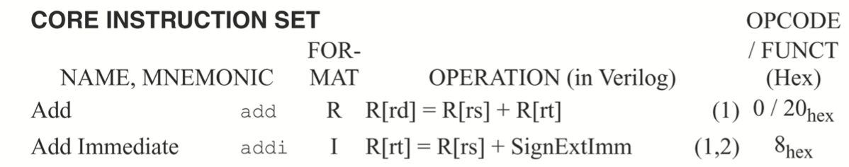
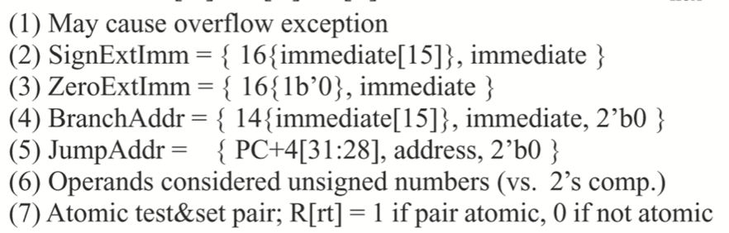
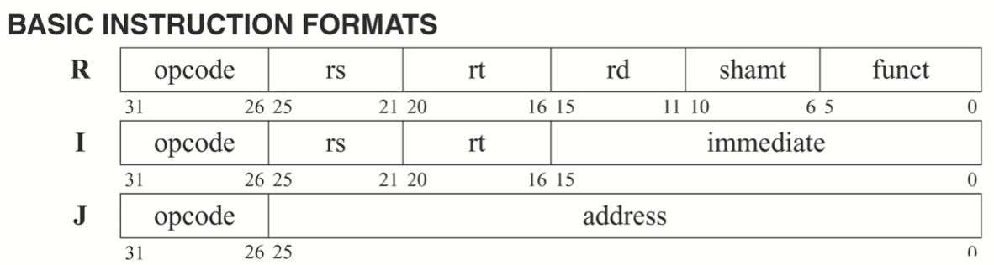
MIPS Reference Data (Green Card)
Ins | Opcode | Funct | Type
add
addi
000000 100000 R
001000 I
Const is 16-bit two's comp.
sign-extended to 32 bits
addiu
Const is 16-bit two's comp.
sign-extended to 32 bits
No overflow trap.
Get familiar with bit numbers!

Slide 7
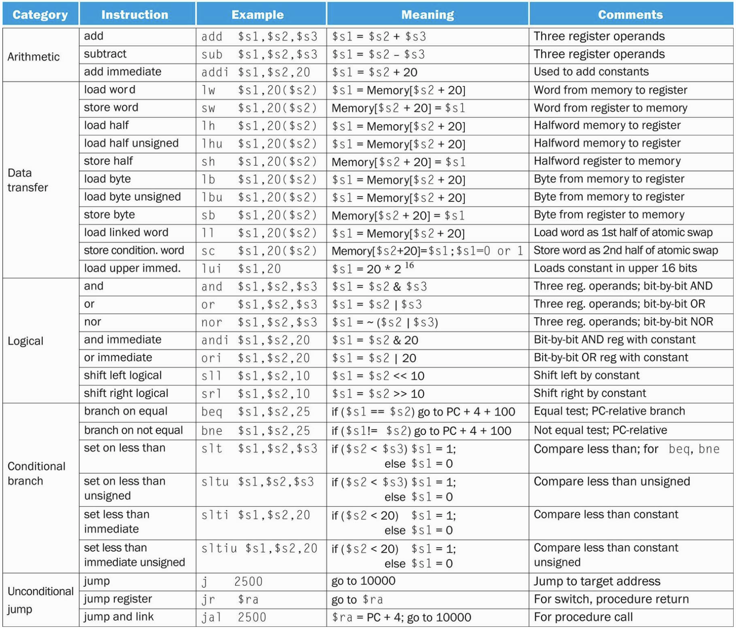
MIPS ALU Operations
Sample coded operation: ADD instruction
R-type:
0
0
0
0
0
0
0
1
0
1
1
0
1
0
0
1
0
1
0
1
0
0
0
0
0
0
1
0
0
0
0
0
op = 0x00 dictating an ALU function
func = 0x20 dictating an add
rs = 11 Reg[11]
source
rd = 10 Reg[10]
destination
rt = 9 Reg[9]
source
unused fields are set to ‘0’
add $10, $11, $9

Slide 8
MIPS Since Cycle Datapath
add rd, rs, rt
add $10, $11, $9
0
0
0
0
0
0
0
1
0
1
1
0
1
0
0
1
0
1
0
1
0
0
0
0
0
0
1
0
0
0
0
0
Bits [31-26]
[25-21]
[20-16]
[15-11]
[10-6]
[5-0]
[15-0]

Slide 9
Function Code Examples
Instruction Function
add rd, rs, rt 100000
addu rd, rs, rt 100001
and rd, rs, rt 100100
break 001101
div rs, rt 011010
divu rs, rt 011011
jalr rd, rs 001001
jr rs 001000
mfhi rd 010000
mflo rd 010010
mthi rs 010001
mtlo rs 010011
mult rs, rt 011000
multu rs, rt 011001
nor rd, rs, rt 100111
or rd, rs, rt 100101
sll rd, rt, sa 000000
sllv rd, rt, rs 000100
slt rd, rs, rt 101010
sltu rd, rs, rt 101011
sra rd, rt, sa 000011
srav rd, rt, rs 000111
srl rd, rt, sa 000010
Instruction Function
srlv rd, rt, rs 000110
sub rd, rs, rt 100010
subu rd, rs, rt 100011
syscall 001100
xor rd, rs, rt 100110

Slide 10
Shift operations
Shifting is a common operation
applied to groups of bits
used for alignment
used for “short cut” arithmetic operations
X << 1 is often the same as 2*X
X >> 1 can be the same as X/2
For example:
X = 20₁₀ = 00010100₂
Left Shift:
(X << 1) = 00101000₂ = 40₁₀
Right Shift:
(X >> 1) = 00001010₂ = 10₁₀
Signed Right Shift requires inserting MSB, which is not always 0
(-X >>> 1) = (11101100₂ >>> 1) =
11110110₂ = -10₁₀

Slide 11
MIPS Shift Operations
Sample coded operation: SHIFT LOGICAL LEFT instruction
R-type:
0
0
0
0
0
0
0
0
0
0
0
0
0
0
1
0
0
0
0
1
0
0
0
1
0
0
0
0
0
0
0
0
op = 0x00 dictating an ALU function
func = 0x00 dictating an sll
unused set to
‘0’
rd = 2 Reg[2]
destination
rt = 2 Reg[2]
source
shamt = 4 dictates a shift of 4-bits
Assembly: sll $2, $2, 4
sll rd, rt, shamt:
Reg[rd] = Reg[rt] << shamt
“Shift the contents of rt to the left by shamt; store the result in rd”

Slide 12
MIPS Shift Operations
Sample coded operation: SLLV (SLL Variable)
R-type:
0
0
0
0
0
0
0
1
0
0
0
0
0
0
1
0
0
0
0
1
0
0
0
0
0
0
0
0
0
1
0
0
op = 0x00 dictating an ALU function
func = 0x04 dictating an sllv
shift
amount
in rs
rd = 2 Reg[2]
destination
rt = 2 Reg[2]
source
unused set to ‘0’
Different flavor:
Shift amount is not in instruction, but in a register
Assembly: sllv $2, $2, $4
sllv rd, rt, rs:
Reg[rd] = Reg[rt] << Reg[rs]
“Shift the contents of rt left by the contents of rs; store the result in rd”

Slide 13
MIPS ALU Operations with Immediate
FACT: In a C compiler (gcc), 52% of ALU operations use a constant!
addi instruction: adds register contents, signed-constant:
I-type:
0
0
1
0
0
0
0
1
0
1
1
0
1
0
0
1
1
1
1
1
1
1
1
1
1
1
1
1
1
1
0
1
OP = 0x08, dictating addi
rs = 11, Reg[11] source
rt = 9, Reg[9] destination
constant field, indicating -3 as second operand
(sign-extended!)
Symbolic version: addi $9, $11, -3
Similar instructions for other ALU operations:
Immediate values are sign-extended for arithmetic and compare operations, but not for logical operations.
addi rt, rs, imm:
Reg[rt] = Reg[rs] + sxt(imm)
arithmetic: addi, addiu
compare: slti, sltiu
logical: andi, ori, xori, lui
“Add the contents of rs to const; store result in rt”

Slide 14
Working with Constants
Examples
add 2000 to register $5
addi $5, $5, 2000
subtract 60 from register $5
addi $5, $5, -60
… no subi instruction!
put the number 1234 in $10
addi $10, $0, 1234
logically AND $5 with 0x8723 and put the result in $7
andi $7, $5, 0x8723
But…
these constants are limited to 16 bits only!
Range is [-32768…32767] if signed, or [0…65535] if unsigned
2¹⁵ = 32768

Slide 15
Beware ADDIU: “add immediate unsigned”
addiu: supposedly “add immediate unsigned”
BUT IS A MISNOMER! Actually sign-extends the immediate.
The difference between addi & addiu is that addiu doesn’t check for overflows
I-type:
0
0
1
0
0
1
0
1
0
1
1
0
1
0
0
1
1
1
1
1
1
1
1
1
1
1
1
1
1
1
0
1
OP = 0x09, dictating addiu
rs = 11, Reg[11] source
rt = 9, Reg[9] destination
constant field, indicating -3 as second operand
(sign-extended!)
Symbolic version: addiu $9, $11, -3
addiu rt, rs, imm:
Reg[rt] = Reg[rs] + sign-ext(imm)
“Add the contents of rs to const; store result in rt”

Slide 16
ORI: Unsigned Constants
ori instruction: bitwise OR’s register to unsigned-constant:
I-type:
0
0
1
1
0
1
0
1
0
1
1
0
1
0
0
1
1
1
1
1
1
1
1
1
1
1
1
1
1
1
0
1
OP = 0x0d, dictating ori
rs = 11, Reg[11] source
rt = 9, Reg[9] destination
constant field, indicating 65533 as second operand
(zero-extended!)
Symbolic version: ori $9, $11, 65533
The imm is 0-padded into a 32-bit unsigned (+ve) number:
00000000000000001111111111111101
ori rt, rs, imm:
Reg[rt] = Reg[rs] | zero-ext(imm)
“OR the contents of rs to const; store result in rt”
Also: All logical operations are always “unsigned”, so always zero-extended:
ori, andi, xori

Slide 17
How About Larger Constants?
Problem: How do we work with bigger constants?
Example: Put the 32-bit value 0x5678ABCD in $5
CLASS: How will you do it?
One Solution:
put the upper half (0x5678) into $5
then shift it left by 16 positions (0x5678 0000)
now “add” the lower half to it (0x5678 0000 + 0xABCD)
addi $5, $0, 0x5678
sll $5, $5, 16
addi $5, $5, 0xABCD
One minor problem with this:
2nd addi can mess up by treating the constants are signed
use ori instead

Slide 18
How About Larger Constants?
Observation: This sequence is very common!
so, a special instruction was introduced to make it shorter
the first two (addi + sll) combo is performed by
lui
“load upper immediate”
puts the 16-bit immediate into the upper half of a register
Example: Put the 32-bit value 0x5678ABCD in $5
lui $5, 0x5678
ori $5, $5, 0xABCD
0101011001111000
0000000000000000
0000000000000000
1010101111001101
0101011001111000
1010101111001101
Reminder: In MIPS, Logical Immediate instructions (ANDI, ORI, XORI) do not sign-extend their constant operand

Slide 19
MIPS Operations

Slide 20
Exercise
Compute the following expression with MIPS Assembly
f = (g + h) – (i + j)
where variables f, g, h, i, and j are assigned to registers $16, $17, $18, $19, and $20 respectively
add $8,$17,$18
add $9,$19,$20
sub $16,$8,$9

